Slide 1
Spring Force and Energy Notes

Slide 2
Spring Force
When a spring is compressed or stretched from its “relaxed” position, the force increases linearly with the distance from equilibrium.
This distance is typically labeled “x” in meters.
The force also depends on how strong the spring.
The “strength” of the spring depends on it’s “k” value, where “k” is called the spring constant.

Slide 3
Spring Force Calculation
F = k x
k = spring constant (Newtons/meter)
x = distance stretched or compressed from relaxed position.

Slide 4
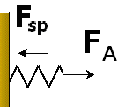
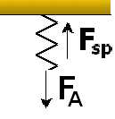
Example
What force is necessary to stretch an ideal spring whose spring constant is 120 N/m by an amount of 0.3m?
F = kx
F = (120 N/m) * (0.3m)
F = 36 N

Slide 5
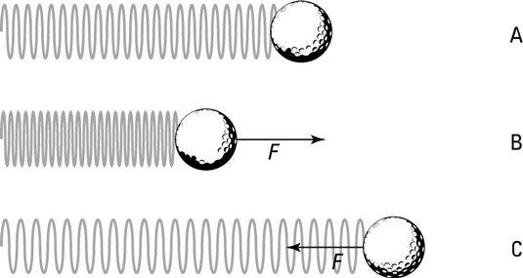
Spring Energy
A spring also stores energy, so this is another form of mechanical energy we can use.

Slide 6
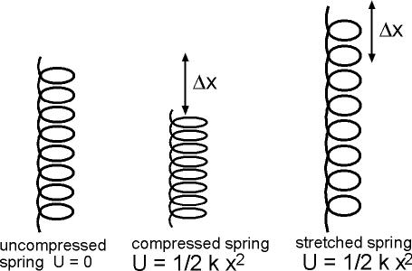
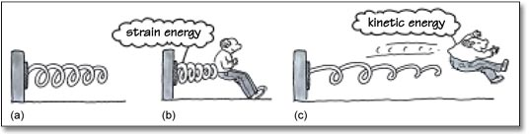
Spring Energy Calculation
Espring = ½ k x²

Slide 7
Example 2
A block of mass 0.5 kg is attached to a spring and is oscillating horizontally on a frictionless table. The spring (400 N/m) is initially stretched by 0.3 m and then released from rest. How fast is the block moving when it reaches the equilibrium position of the spring?

Slide 8
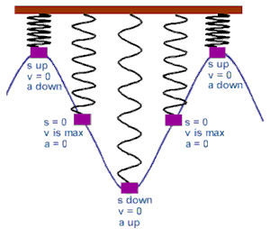
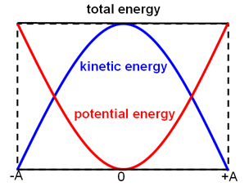
Example 2

Slide 9
A block of mass 0.5 kg is attached to a spring and is oscillating horizontally on a frictionless table. The spring (400 N/m) is initially stretched by 0.3 m and then released from rest. How fast is the block moving when it reaches the equilibrium position of the spring?
TE = KE + PE
TE = PE = E_{spring} = ½ kx²
TE = KE = ½ mv²
½ mv² = ½ kx²
v² = kx²/m = (400 N/m)*(0.3m)² / (0.5kg)
v² = 72 (m/s) ² → 8.48 m/s

